Slide 1
Self inductance
A voltage is induced in coil when there is a time rate of change of current through it. The inductance parameter L is defined in terms of the voltage across it and the time rate of change of current through it
Where v(t) is the voltage across the coil
i(t) is the current through the coil and
L is the inductance of the coil

Slide 2
Mutual inductance
Mutual inductance is property associated with two or more coils or inductors which are in close proximity and the presence of common magnetic flux which links the coil
A transformer is such a device whose operation is based on mutual inductance

Slide 3
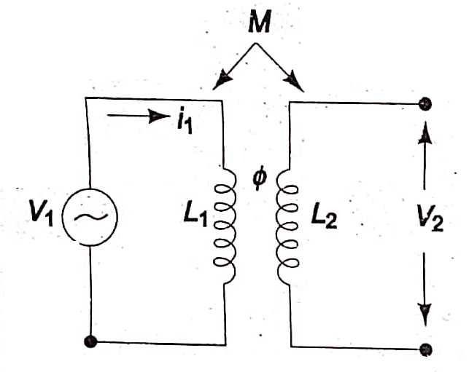
Let us consider two. coils, L₁ and L₂ as shown in Fig.
which are sufficiently close together, so that the flux produced by i₁ in coil L₁ also link coil L₂. We assume that the coils do not move with respect to one another and the medium in which the flux is established has a constant permeability

Slide 4
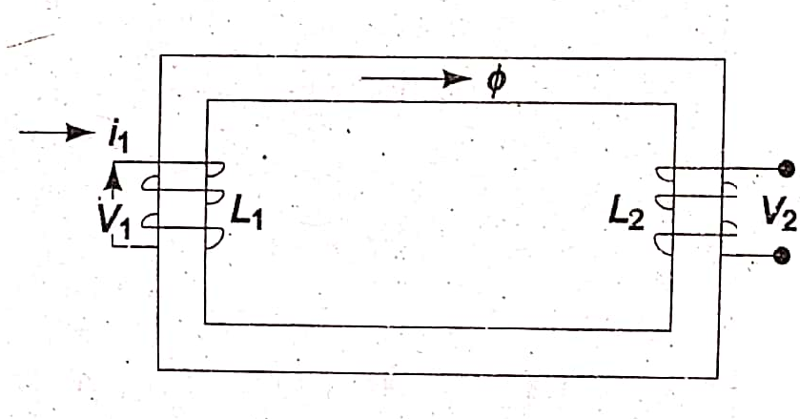
The two coils may be also arranged on a common magnetic core, as shown in Fig
The two coils are said to be magnetically coupled, but act as a separate circuits. It is possible to relate the voltage induced in one coil to the time rate of change of current in the other coil.

Slide 5
When a voltage V₁, is applied across L₁,a current i₁ will start flowing in this coil, and produce a flux .
This flux also links coil L₂.if i₁ were to change with respect to time, the flux would also change with respect to time.
The time varying flux surrounding the second coil, L₂ induces an emf, or voltage, across the terminals of L₂;
this voltage is proportional to the time rate of change of current Flowing through the first coil L₁.
The two coils, or circuit, is said to be inductively coupled,

Slide 6
because of this property they are called coupled elements or coupled circuits and the induced voltage or emf is called the voltage/emf of mutual induction and is given by
Where v₂(t)is the voltage induced in coil L₂ and M₁ is the coefficient of proportionality, and is called the coefficient of mutual inductance, or
simple mutual inductance.

Slide 7
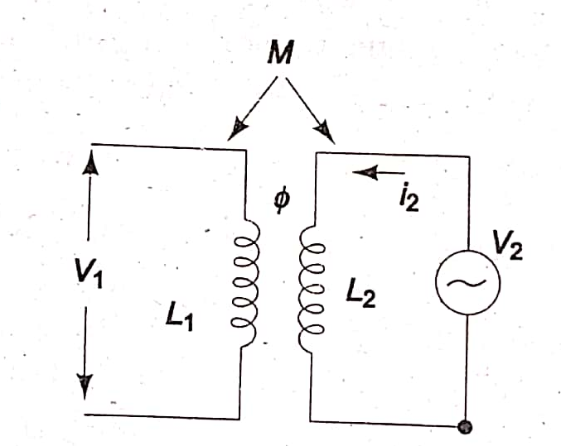
If current i₂ is made to pass through coil L₂ shown in Fig
With the coil L₁ open, a change of i₂ would cause a voltage v1 in coil L₁, given by
In the above equation, another coefficient of proportionality M₂ is involved

Slide 8
Though it appears that two mutual inductances are involved in determining the mutually induced voltages in the two coils, it can be shown from energy considerations that the two coefficients are equal and, therefore, need not be represented by two different letters.
Thus M₁ = M₂= M.

